Slide 1
Tutorial 8:
Working with
Advanced Functions

Slide 2
Objectives
Use the IF function
Use the AND function
Use the OR function
Use structured references in formulas
Nest the IF function
Use the VLOOKUP function

Slide 3
Objectives
Use the HLOOKUP function
Use the IFERROR function
Use conditional formatting to highlight duplicate values
Summarize data using the COUNTIF, SUMIF, and AVERAGEIF functions

Slide 4
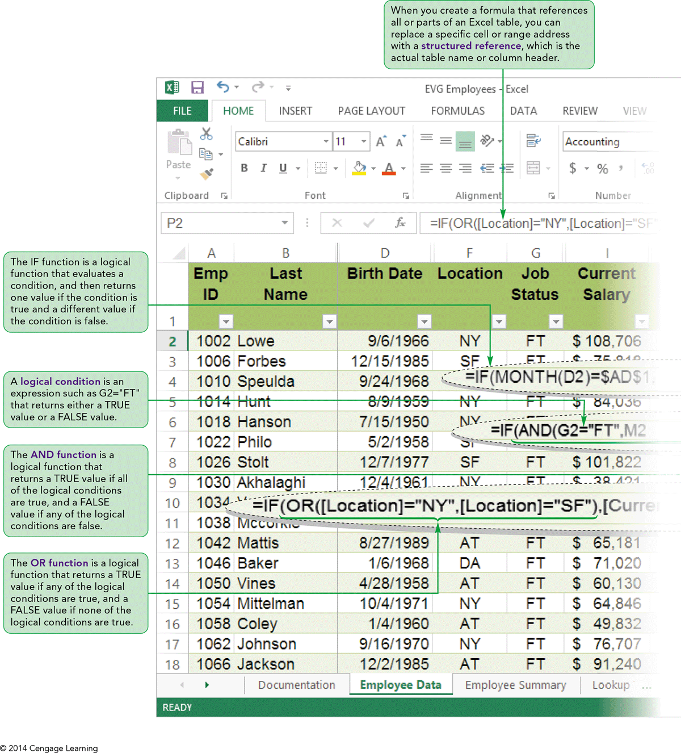
Visual Overview: Logical Functions

Slide 5
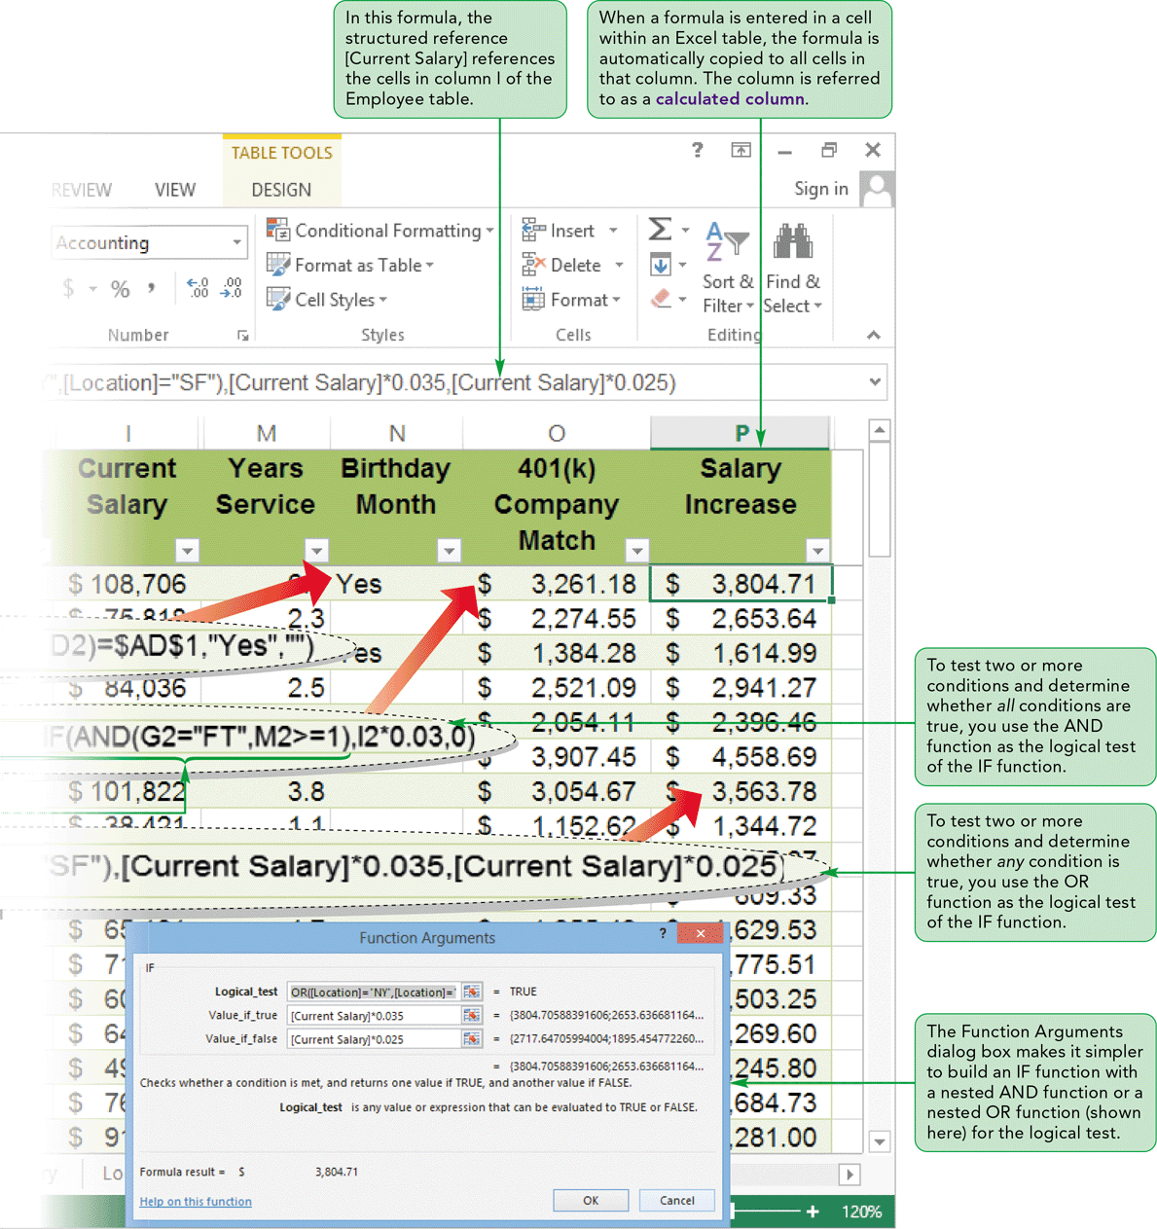
Visual Overview: Logical Functions

Slide 6
Working with Logical Functions
Logical functions (IF, AND, and OR) determine whether a condition is true or false
Conditions use a comparison operator
(<, <=, =, <>, >, or >=) to compare two values
Combine two or more functions in one formula to create more complex conditions

Slide 7
Working with Logical Functions
Inserting Calculated Columns in an Excel Table
  Entering a formula in one cell of a column automatically copies the formula to all cells in that column
  To modify the formula in a calculated column:
    Edit the formula in any cell in the column
    Formulas in all cells in the column are modified
  To edit only one cell in a calculated column:
    Enter a value or a formula that is different from all others in that column

Slide 8
Working with Logical Functions
To effectively communicate a table’s function, keep the following guidelines in mind when creating fields in an Excel table:
  Create fields that require the least maintenance
  Store smallest unit of data possible in a field
  Apply a text format to fields with numerical text data

Slide 9
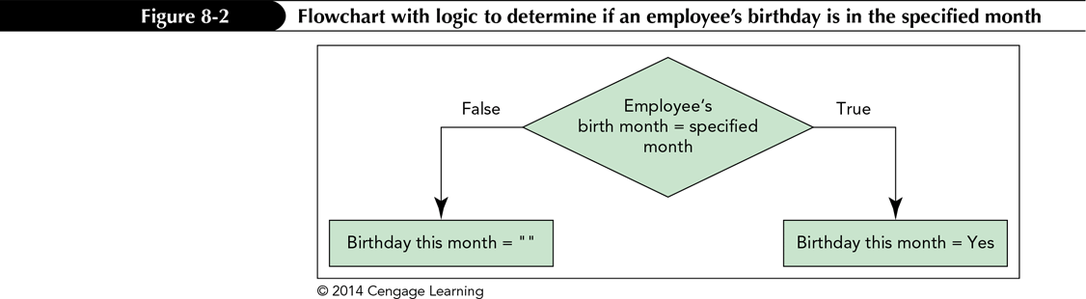
Working with Logical Functions
Using the IF Function
  A logical function that evaluates a single condition and results in only one value
  Returns one value if the condition is true and another value if the condition is false
  Syntax: IF(logical_test, value_if_true, value_if_false)

Slide 10
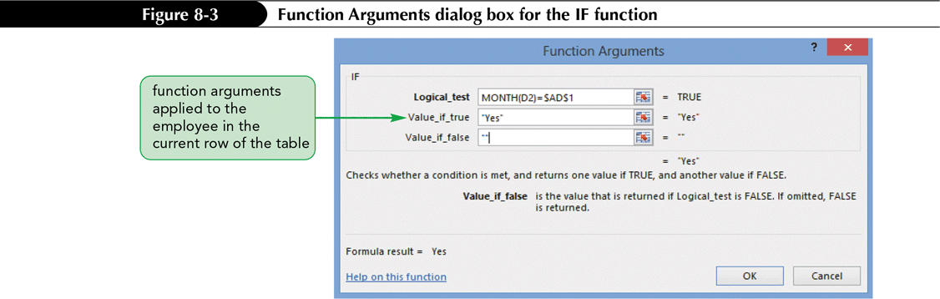
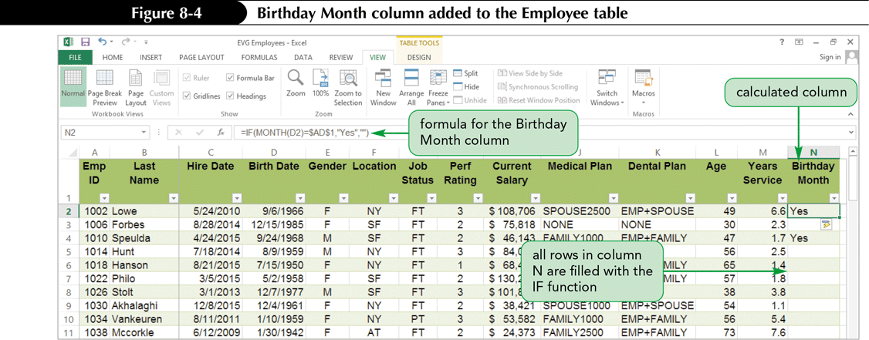
Working with Logical Functions

Slide 11
Working with Logical Functions
Using the AND Function
  A logical function that tests two or more conditions (up to 255) and determines whether all conditions are true
  Returns the value TRUE if all logical conditions are true and the value FALSE if any or all logical conditions are false
  Syntax: AND(logical1[,logical2]...)

Slide 12
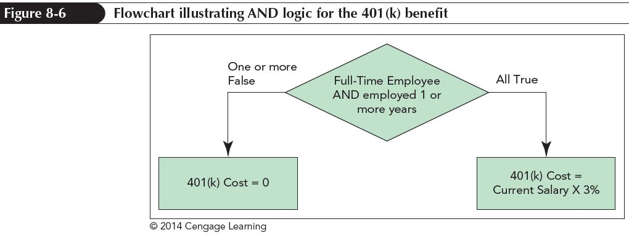
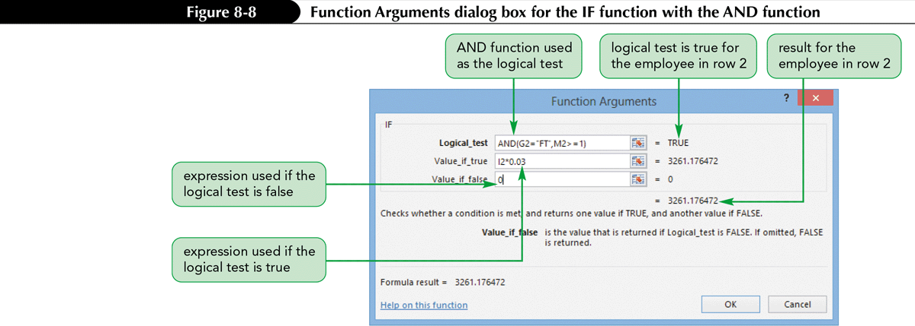
Working with Logical Functions

Slide 13
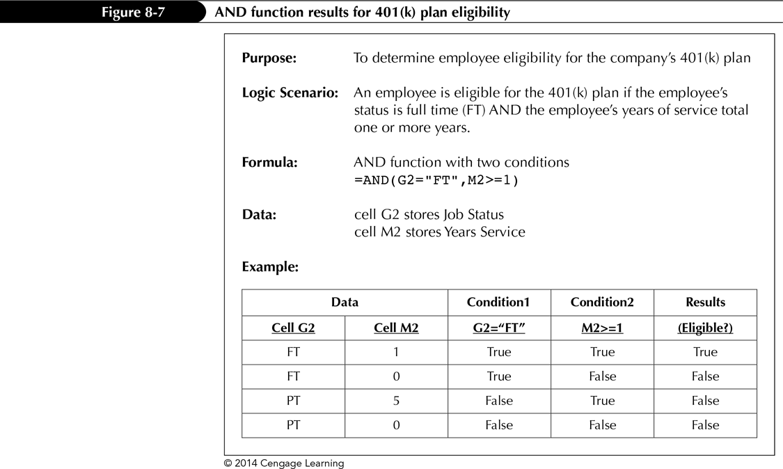
Working with Logical Functions

Slide 14
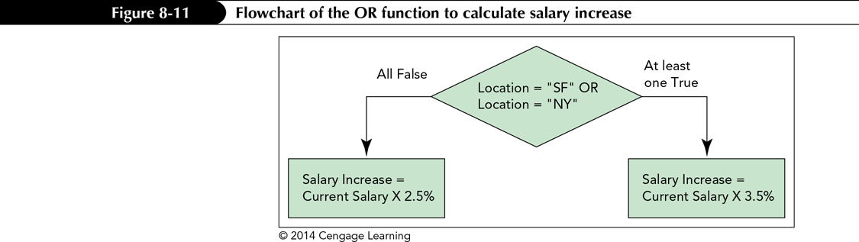
Working with Logical Functions
Using the OR Function
  A logical function that returns a TRUE value if any of the logical conditions (up to 255) are true and a FALSE value if all the logical conditions are false
  Syntax: OR(logical1[,logical2]...)

Slide 15
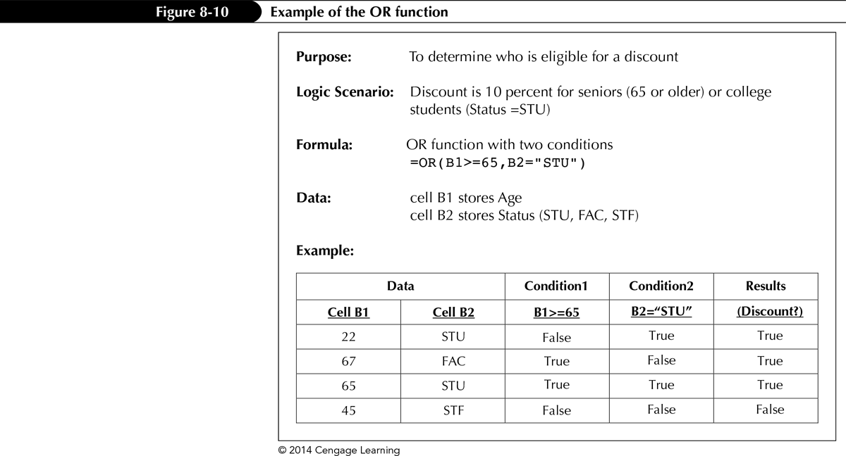
Working with Logical Functions

Slide 16
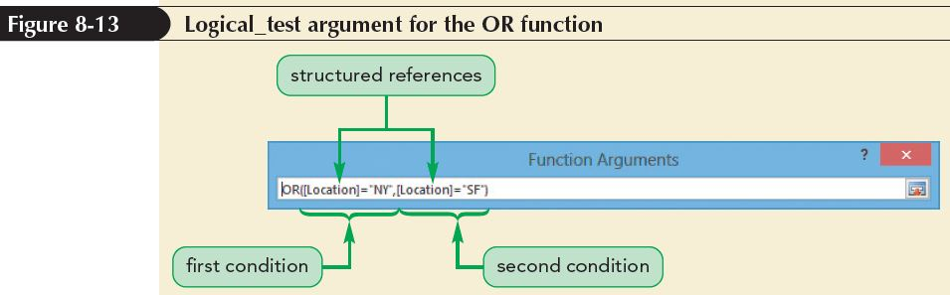
Using Structured References to Create Formulas in Excel Tables
Replace specific cell or range address with a structured reference, the actual table name, or a column header
A formula that includes a structured reference can be fully qualified or unqualified

Slide 17
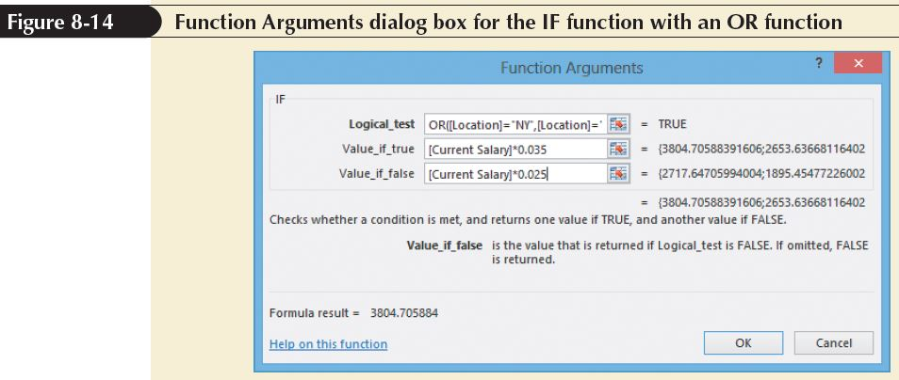
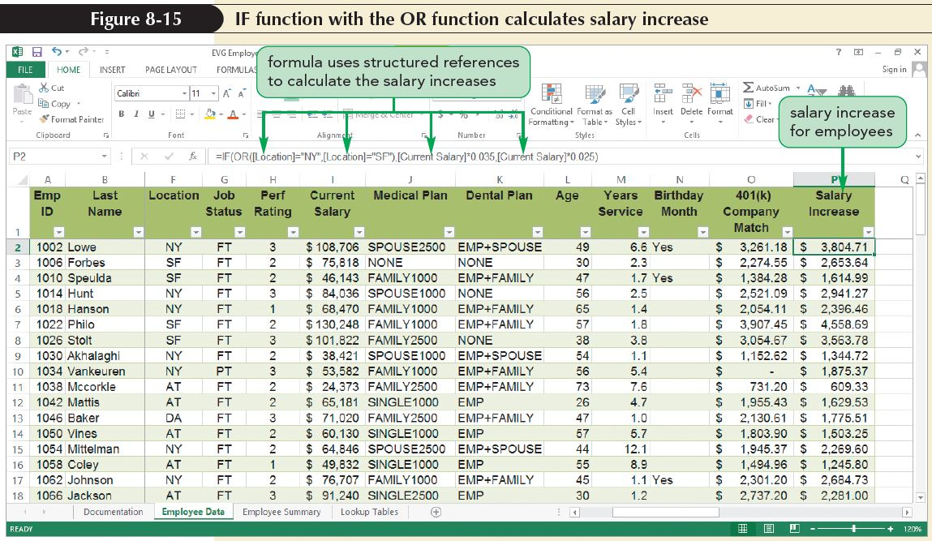
Using Structured References to Create Formulas in Excel Tables

Slide 18
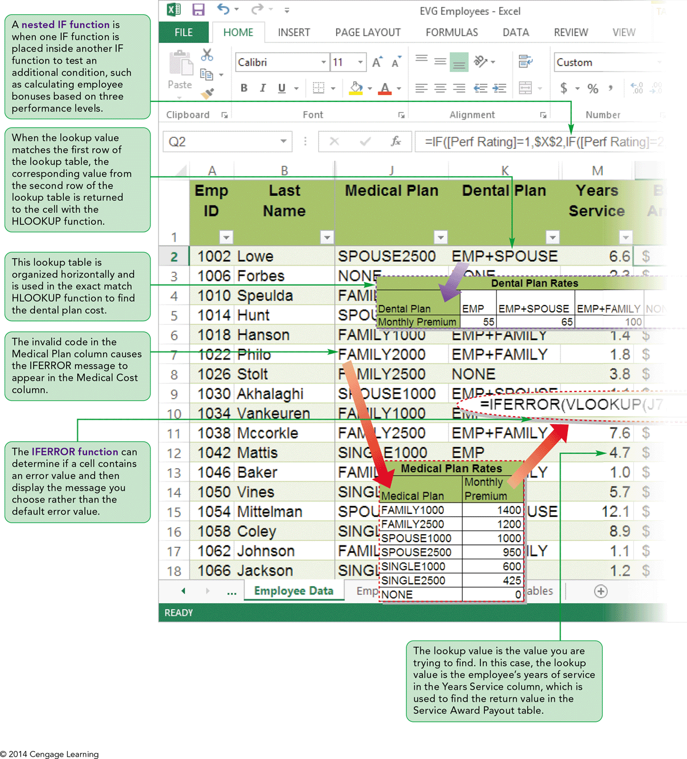
Visual Overview:
Nested IFs and Lookup Tables

Slide 19
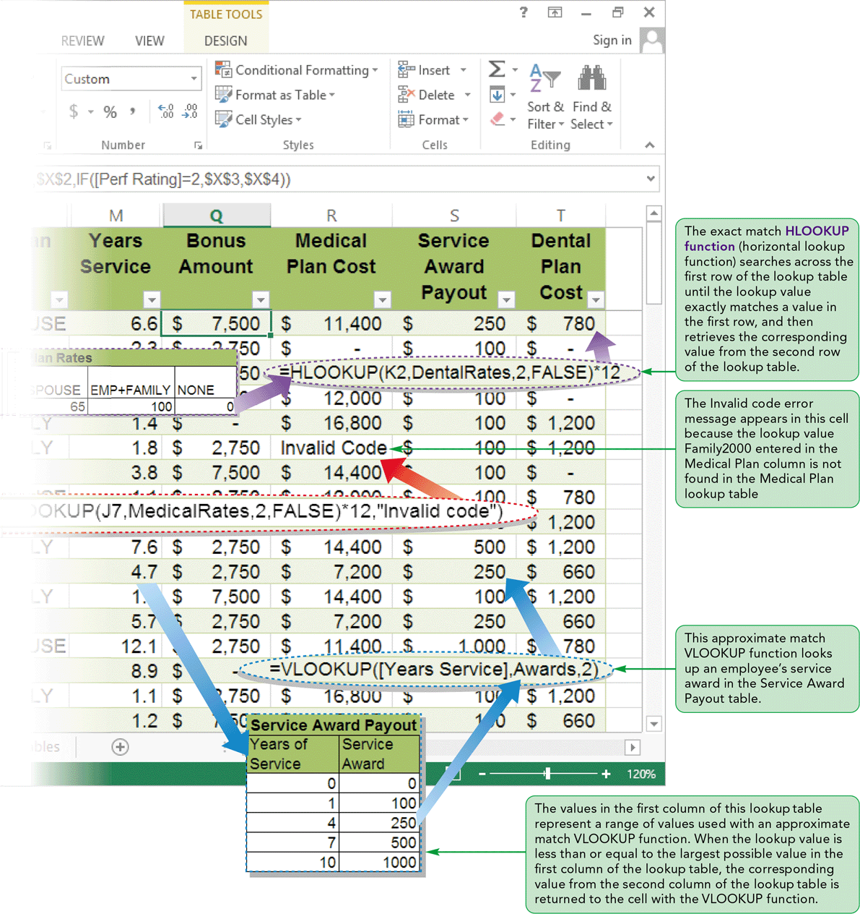
Visual Overview:
Nested IFs and Lookup Tables

Slide 20
Creating Nested IFs
To allow for three or more outcomes
One IF function is placed inside another IF function to test an additional condition
More than one IF function can be nested

Slide 21
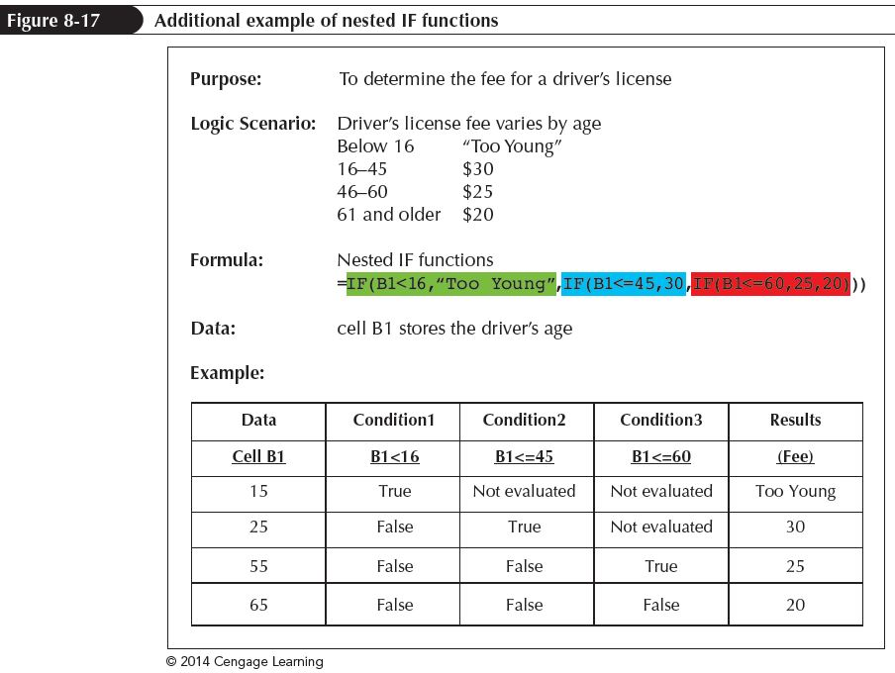
Creating Nested IFs

Slide 22
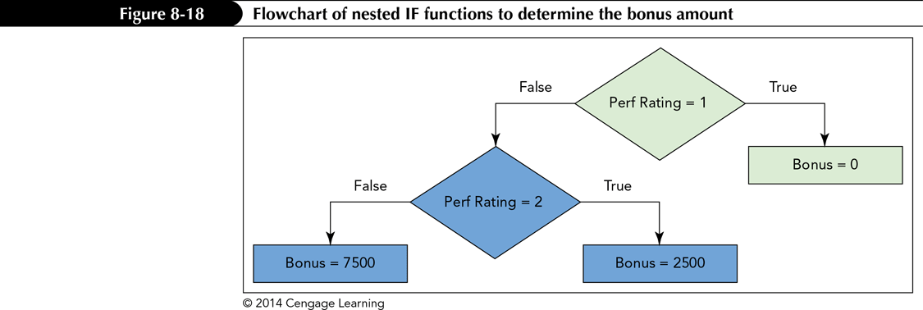
Creating Nested IFs
The following formula and flowchart convey the same nested IF function
=IF([Perf Rating]=1,0,IF([Perf Rating]=2,2500,7500))

Slide 23
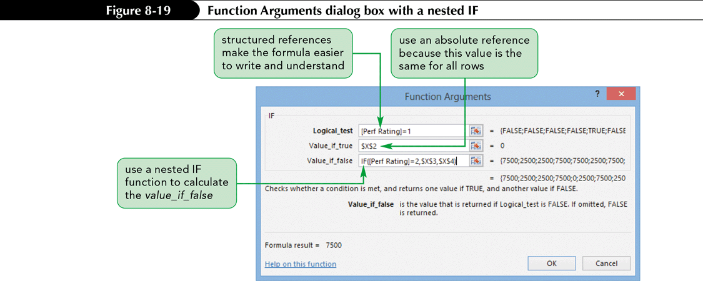
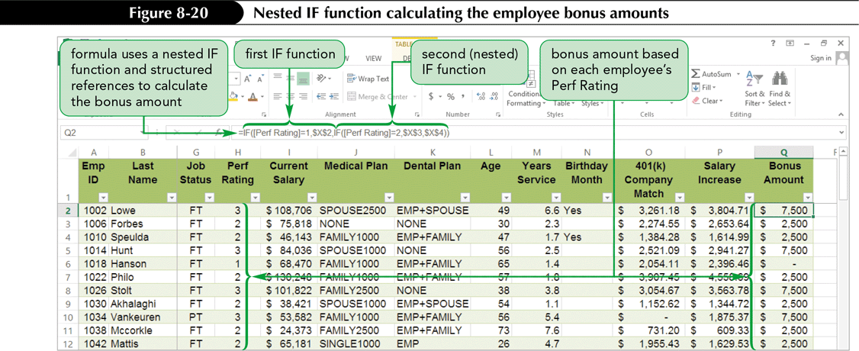
Creating Nested IFs

Slide 24
Using LOOKUP Functions
Lookup functions allow you to use tables of data to find values in a table and insert them in another worksheet location
Both the VLOOKUP and HLOOKUP functions are used to return a value from a lookup table
  The VLOOKUP function always searches for a value in the first column of the lookup table
  The HLOOKUP function always searches for a value in the first row of the lookup table

Slide 25
Using LOOKUP Functions
Lookup tables can be constructed as either exact match or approximate match lookups
  Exact match lookup occurs when the lookup value must match one of the values in the first column (or row) of the lookup table
  An approximate match lookup occurs when the lookup value is found within a range of numbers in the first column (or row) of the lookup table

Slide 26
Using LOOKUP Functions
Using the VLOOKUP Function to Find an Exact Match
  Searches vertically down the first column of the lookup table
  Syntax:

Slide 27
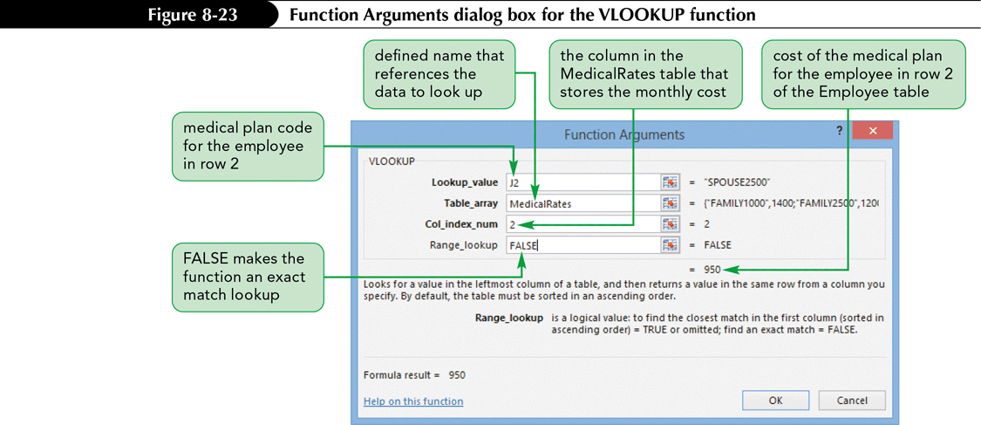
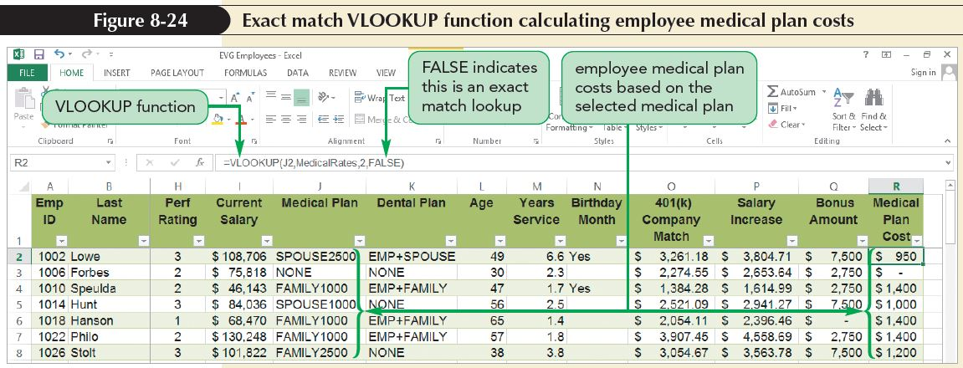
Using LOOKUP Functions

Slide 28
Using LOOKUP Functions
Using the VLOOKUP Function to Find an Approximate Match
  Returns a value based on an approximate match lookup in the first column of the table
  The values in the first column or row of a lookup table can represent a range of values
  Quantity discounts, shipping charges, and income tax rates are a few examples of approximate match lookups

Slide 29
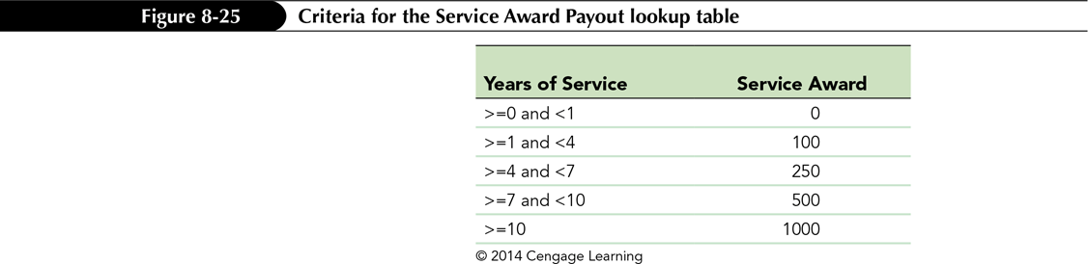
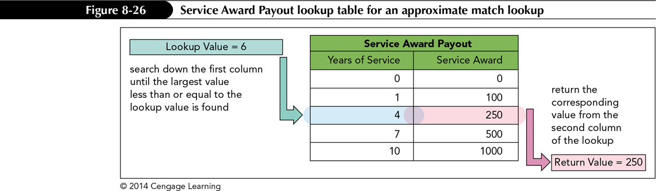
Using LOOKUP Functions

Slide 30
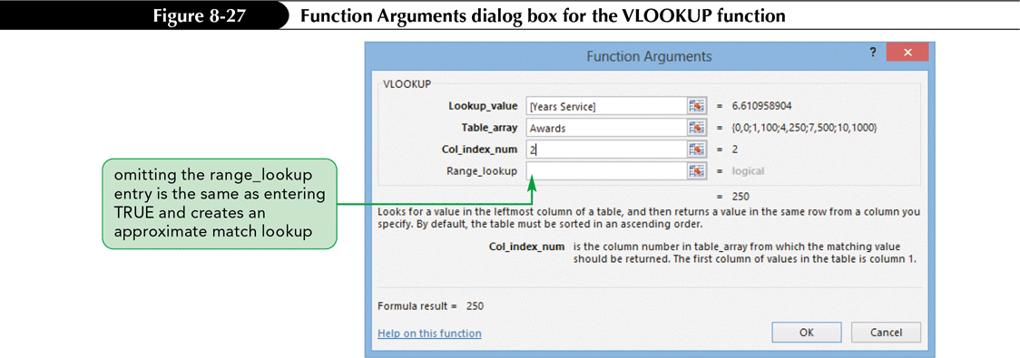
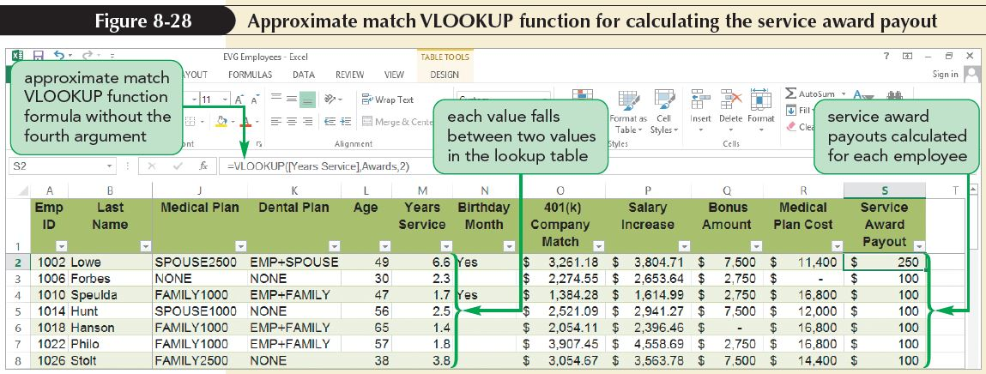
Using LOOKUP Functions

Slide 31
Using the LOOKUP Function
Using the HLOOKUP Function to Find an Exact Match
  Searches horizontally across top row of table and retrieves the value in the column you specify
  Use when comparison values are located in the first row of the lookup table and you want to look down a specified number of rows to find the data to enter in another cell
  Syntax:

Slide 32
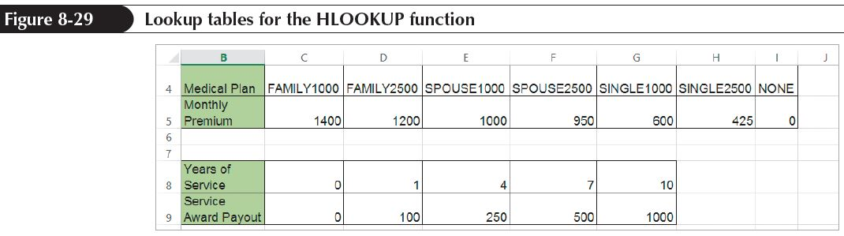
Using the LOOKUP Function
Using the HLOOKUP Function to Find an Exact Match (continued)
  Major difference between HLOOKUP and VLOOKUP functions is the way lookup tables are organized

Slide 33
Using the IFERROR Function
Error values
  Indicate that an element in a formula or a cell referenced in a formula is preventing Excel from returning a calculated value
  Begin with a number sign (#) followed by an error name that indicates the type of error

Slide 34
Using the IFERROR Function
Displays a more descriptive message that helps users fix the problem
Can determine if a cell contains an error value and then display the message you choose rather than the default error value
Use the IFERROR function to find and handle formula errors
Syntax: IFERROR(expression,valueIfError)

Slide 35
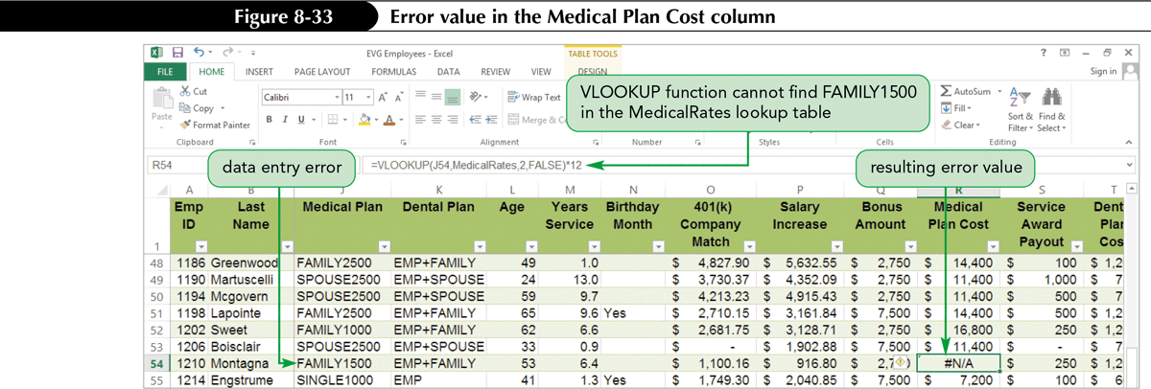
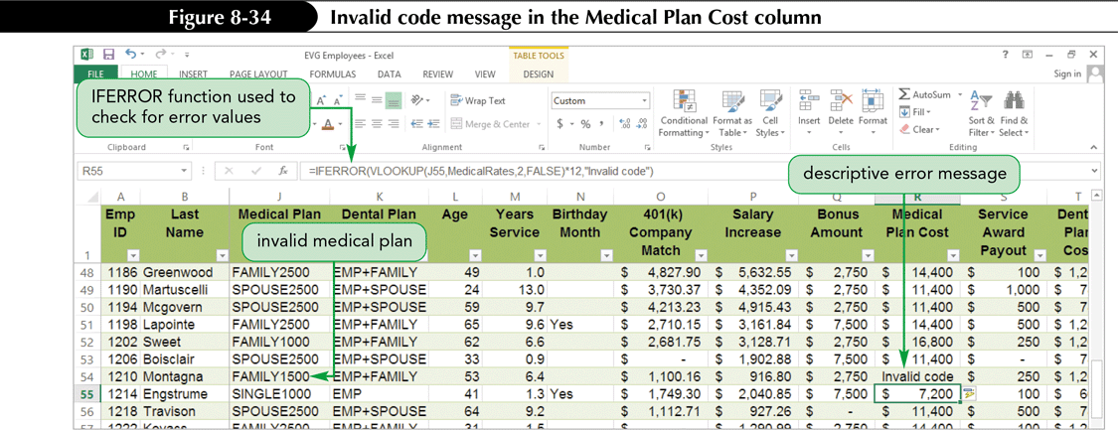
Using the IFERROR Function

Slide 36
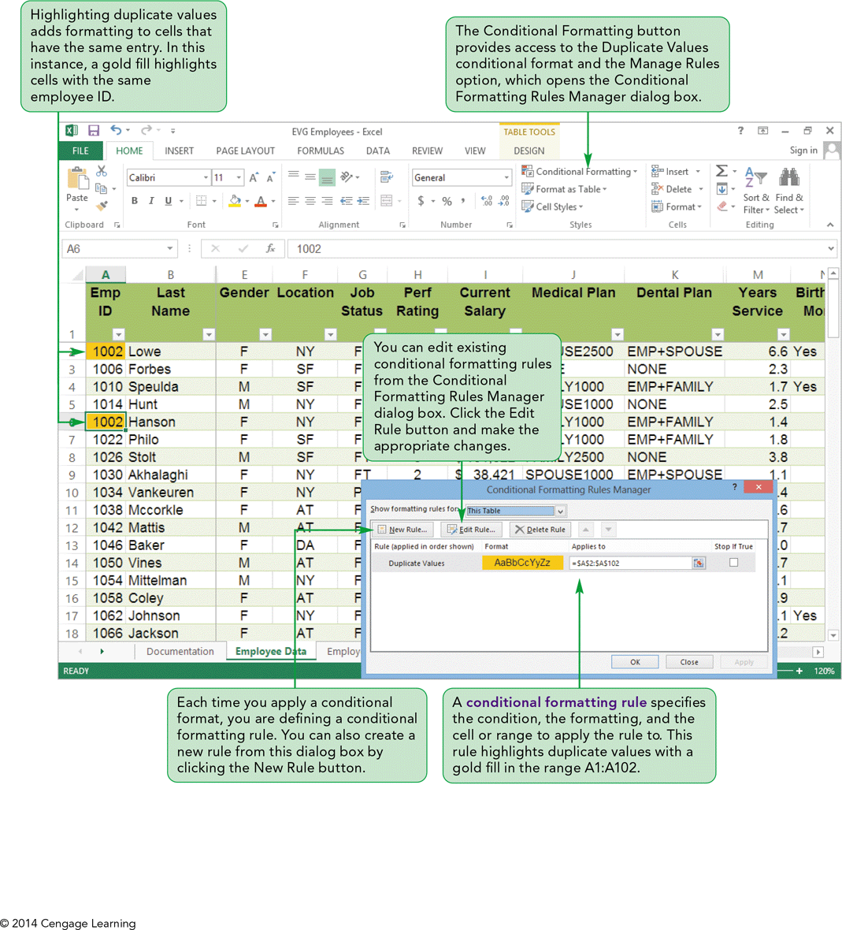
Visual Overview: Conditional Formatting and Functions

Slide 37
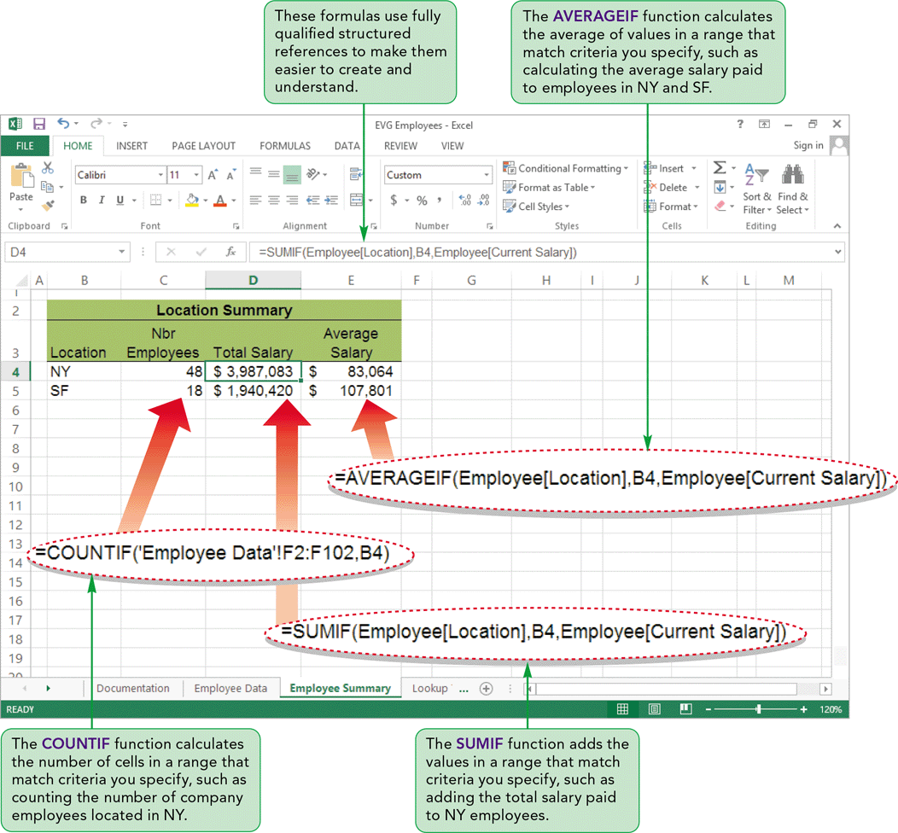
Visual Overview: Conditional Formatting and Functions

Slide 38
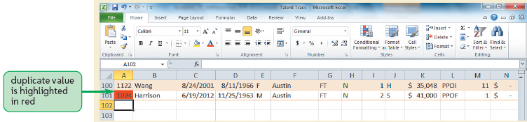
Applying Conditional Formatting
Changes a cell’s formatting when its contents match a specified condition
Can be used to:
  Highlight cells based on their values
  Add data bars that graph relative values in a range
  Highlight duplicate values in a column of data

Slide 39
Applying Conditional Formatting
Highlighting Duplicate Values
  Excel is often used to manage lists of data, such as:
    Employee information
    Inventory
    Phone numbers
  Some of the data is unique for each record, such as an employee ID or a social security number
  One way to identify unintended duplicate entries is to use conditional formatting to highlight duplicate values in a range with a font and/or fill color

Slide 40
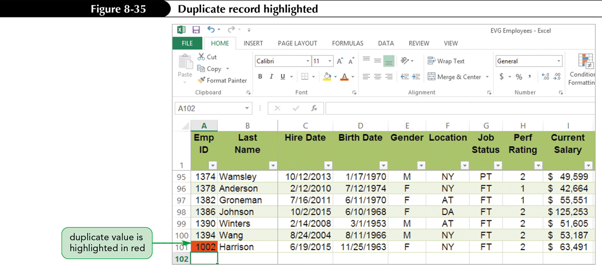
Applying Conditional Formatting

Slide 41
Applying Conditional Formatting
Using the Conditional Formatting Rules Manager
  A conditional formatting rule specifies:
    Type of condition
    Type of formatting when that condition occurs
    Cell or range the formatting is applied to
  Use Conditional Formatting Rules Manager dialog box to edit existing conditional formatting rules

Slide 42
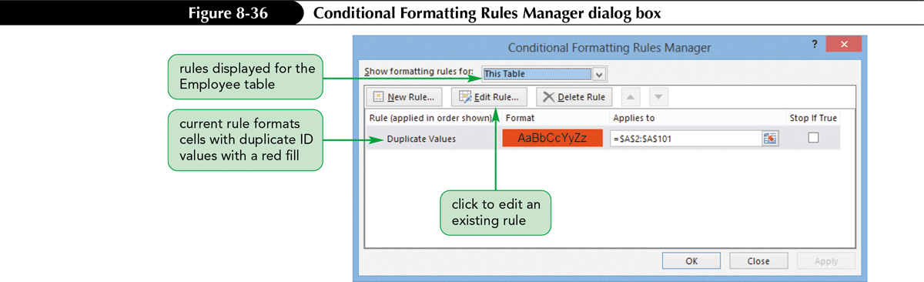
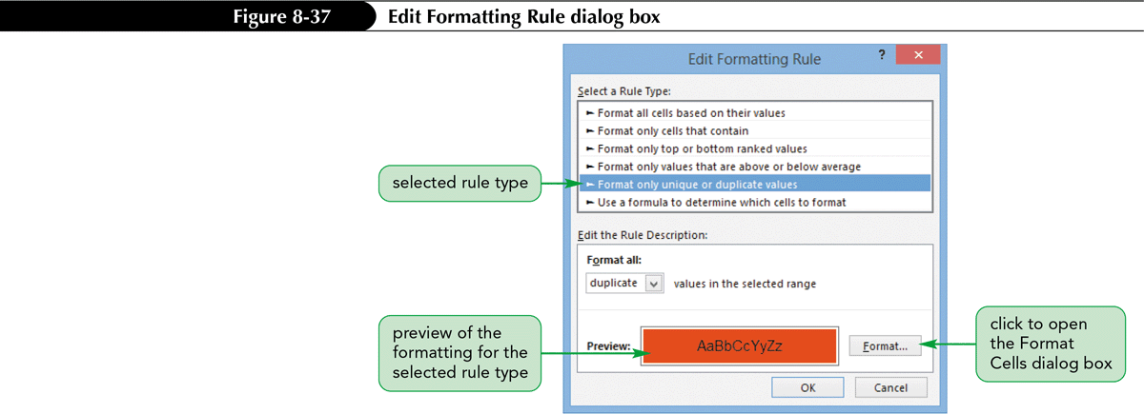
Applying Conditional Formatting

Slide 43
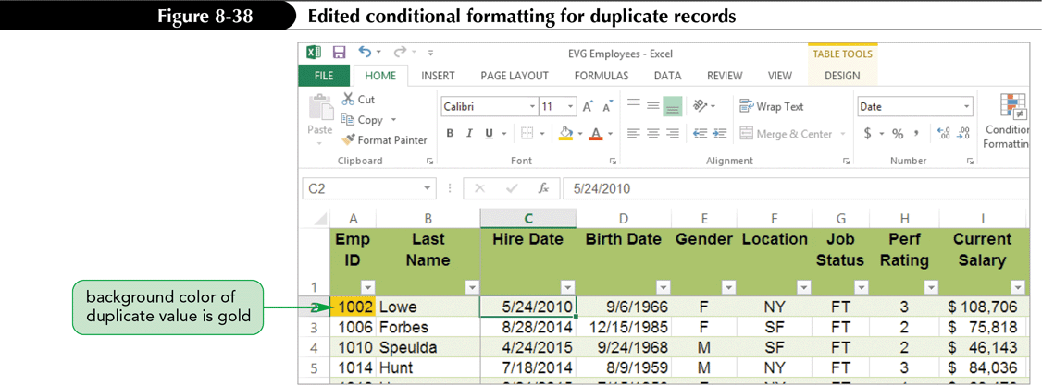
Applying Conditional Formatting

Slide 44
Using Functions to Summarize Data Conditionally
Use COUNTIF, SUMIF, and AVERAGEIF functions to calculate a conditional count, sum, or average using only cells that meet a particular condition
Using the COUNTIF Function
  Calculates the number of cells in a range that match specified criteria
  Sometimes referred to as a conditional count
  Syntax: COUNTIF(range, criteria)

Slide 45
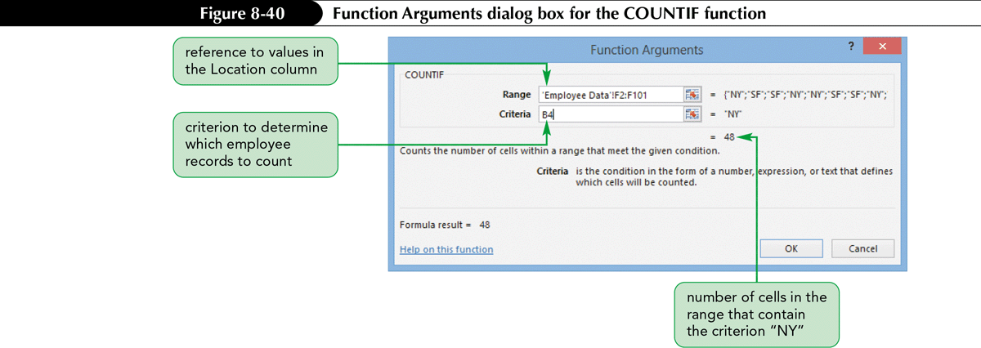
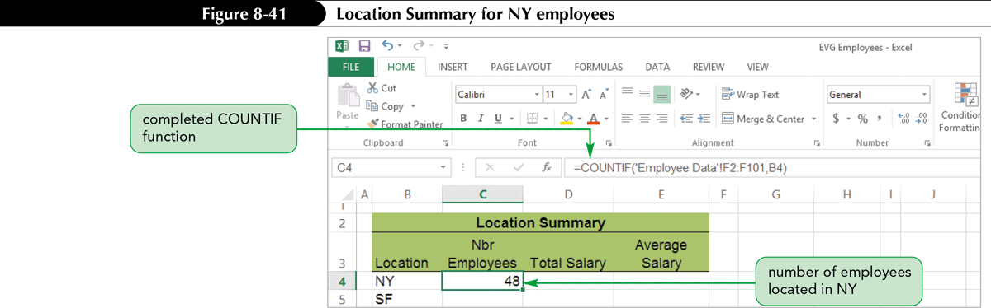
Using Functions to Summarize Data Conditionally

Slide 46
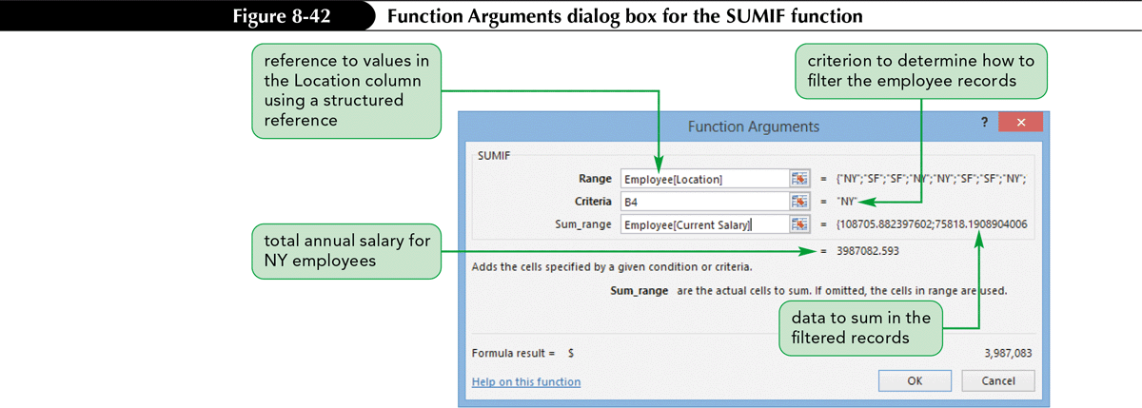
Using Functions to Summarize Data Conditionally
Using the SUMIF Function
  Adds values in a range that meet your criteria
  Also called a conditional sum
  Syntax: SUMIF(range, criteria[, sum_range])

Slide 47
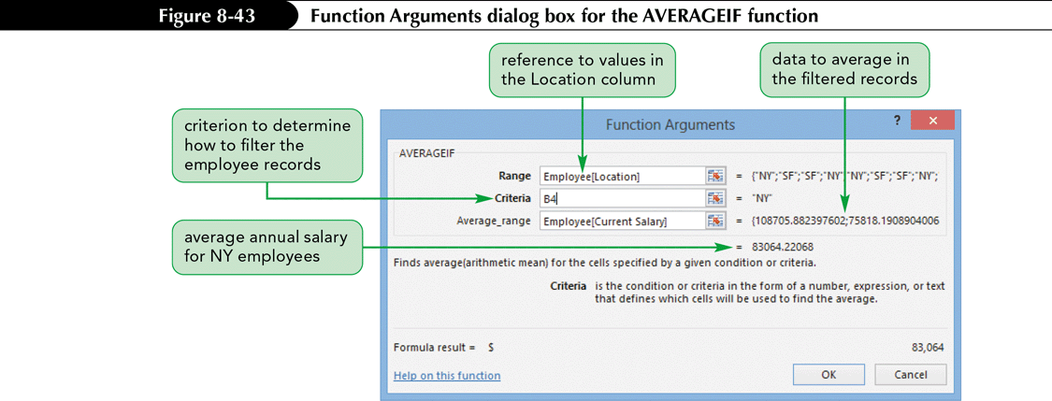
Using Functions to Summarize Data Conditionally
Using the AVERAGEIF Function
  Similar to SUMIF function
  Calculates the average of values in a range that meet criteria you specify
  Syntax: AVERAGEIF(range, criteria[, average_range])

Slide 48
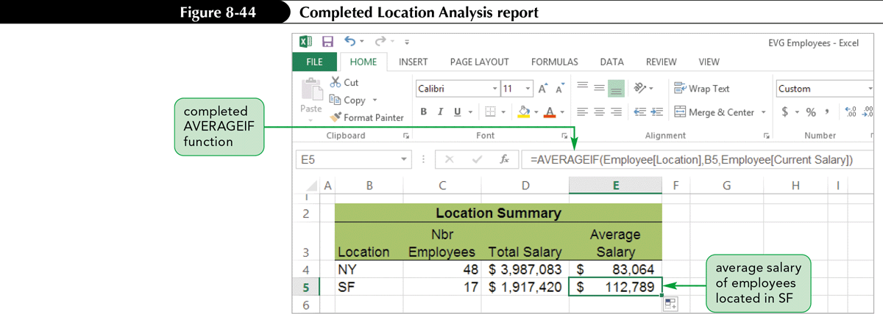
Using Functions to Summarize Data Conditionally

